Slide 1


NEXT GEN EMPLOYABILITY PROGRAM
CREATING A FUTURE-READY WORKFORCE
Student Name :
Karthik M
Student ID :
College Name :
STU6593d7fb462321704187899
Global Academy of Technology

Slide 2
CAPSTONE PROJECT SHOWCASE
Project Title
Recipe Sharing Platform with React and ExpressJS Framework
Abstract | Problem Statement | Project Overview | Proposed Solution | Technology Used | Modelling & Results | Conclusion | Q&A

Slide 3
Abstract
1
The project features a full-stack architecture with a React.js frontend and a Node.js/Express backend.
2
Users have the ability to post recipes, leave comments, receive notifications, and manage their accounts, while an admin panel is available for content moderation.
3
The server operates on a designated port defined by an environment variable (PORT), and API endpoints are set up to manage authentication, recipes, and user actions.
4
The platform is expected to use a database (such as MongoDB) for storing recipes and user information, with JWT-based authentication ensuring security.

Slide 4


Problem Statement
Many food enthusiasts, home cooks, and chefs struggle to find an interactive and user-friendly platform to share and discover recipes while engaging with a like-minded community. Existing solutions often lack features like real-time comments, notifications, and secure user authentication, making it difficult for users to interact and manage their content effectively. RecipeHub addresses this gap by providing a full-stack web platform that enables users to create, share, and engage with recipes, while ensuring seamless API communication between the frontend and backend, secure authentication, and an intuitive

Slide 5

Project Overview
RecipeHub is a full-stack web application designed to allow users to share, explore, and engage with recipes in an interactive environment. The platform features a React.js frontend and a Node.js/Express backend, ensuring seamless API communication. Users can create accounts, post recipes, comment on others' posts, receive real-time notifications, and interact with the community. The backend handles secure and manages user data and recipes through a MongoDB database. Additionally, an admin panel allows for content moderation. The project is built with scalability in mind, making it suitable for both small and large user bases.

Slide 6
Proposed Solution
To address the lack of an interactive and user-friendly recipe-sharing platform, RecipeHub offers a full-stack web application that enables users to create, share, and engage with recipes in a seamless and secure environment.
The frontend, built with React.js, provides an intuitive and responsive user interface, while the backend, developed using Node.js and Express.js, ensures efficient data management and API communication.
MongoDB is used as the database to store user-generated content securely.
The platform includes user authentication , allowing users to register, log in, and manage their accounts safely.
Users can post recipes, comment, like, and receive notifications, fostering community engagement. An admin panel ensures proper content moderation.
By implementing RESTful APIs, Axios-based API calls, and a structured backend architecture, RecipeHub ensures scalability, security, and high performance for an enhanced user experience.

Slide 7
Technology used
Frontend:
React.js – Used to create a dynamic and responsive user interface.
Axios – Utilized for making API requests to the backend.
React Router – Manages client-side navigation.
CSS/Bootstrap/Tailwind – Employed for styling and UI design, depending on the implementation.
Backend:
Node.js – Handles server-side execution.
Database & Storage: MongoDB – A NoSQL database for storing user, recipe, and comment data.

Slide 8
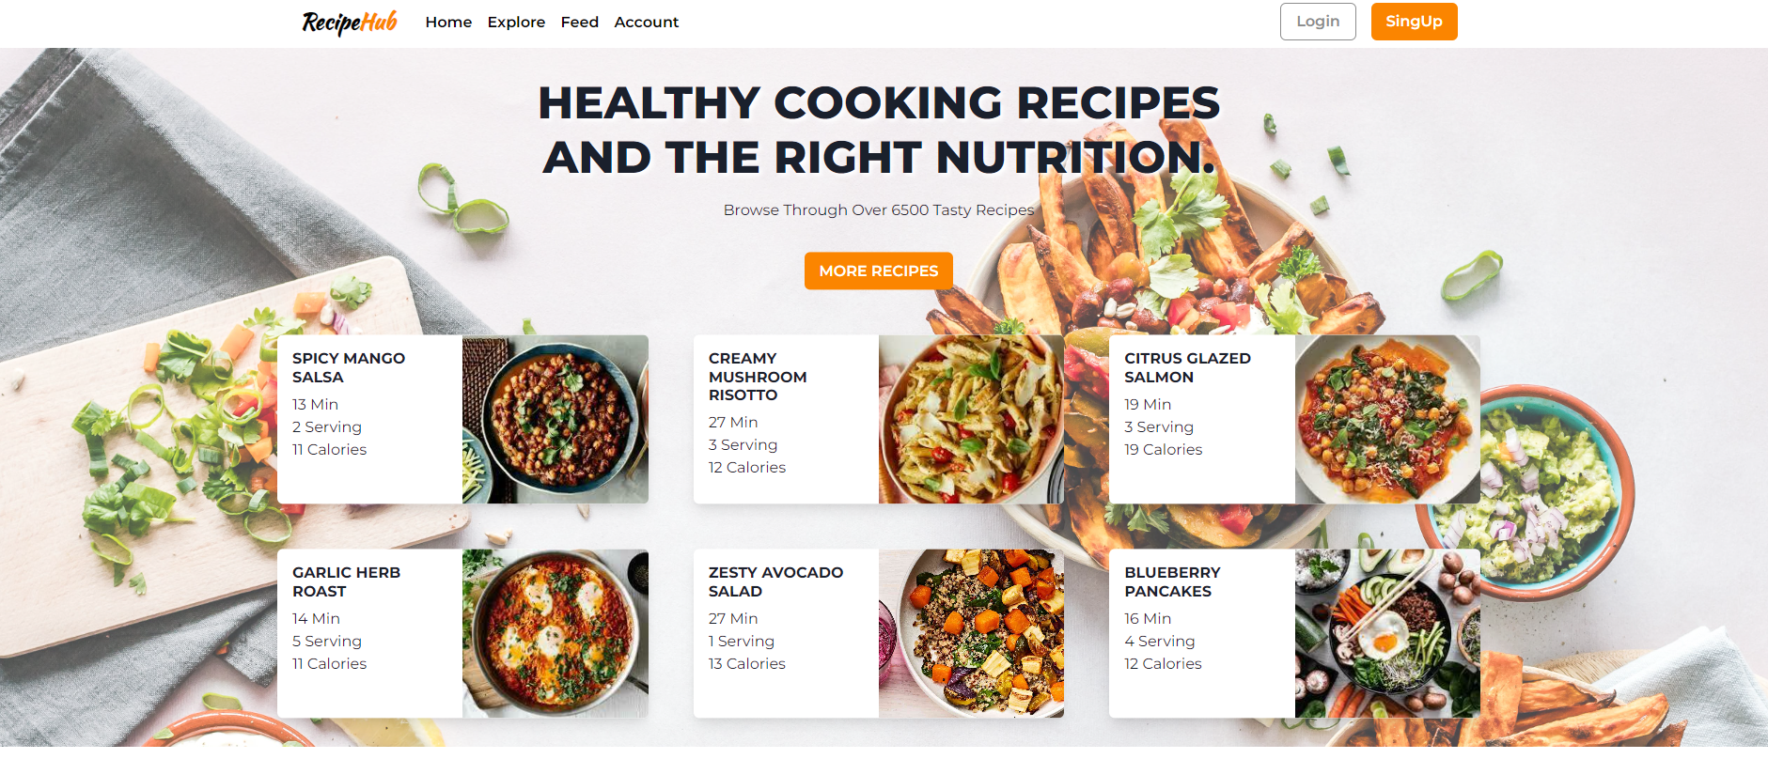
Modelling & Result

Slide 9
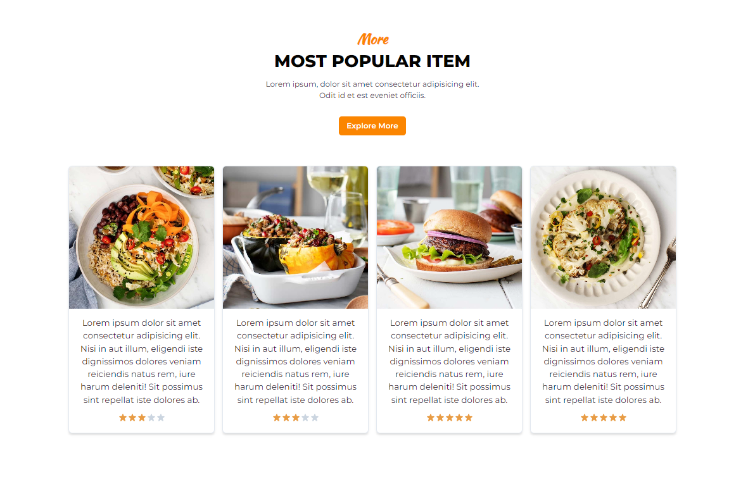
Modelling & Result

Slide 10
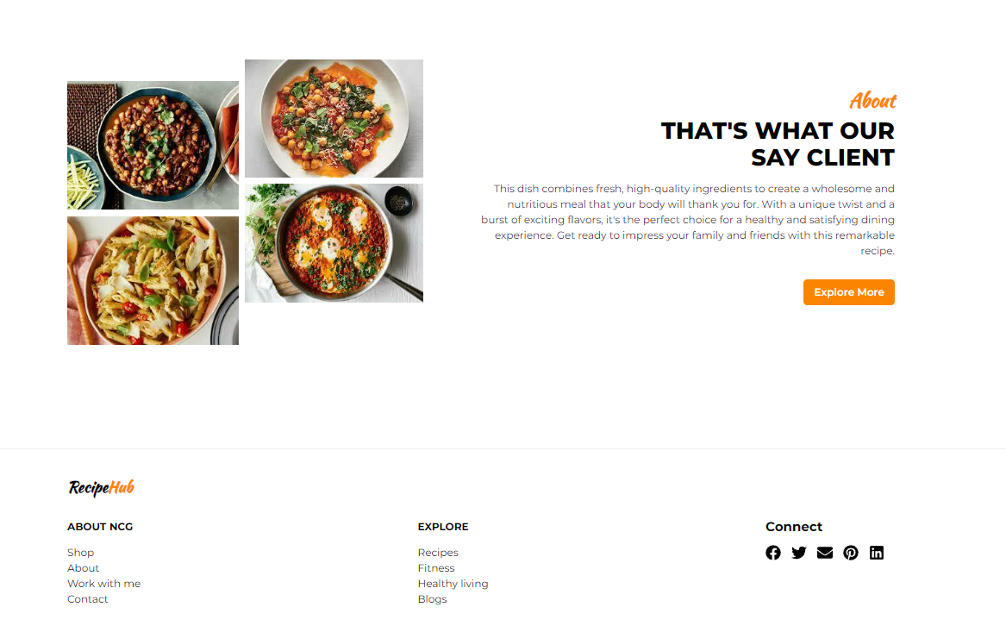
Modelling & Result

Slide 11

Conclusion
RecipeHub is a dynamic platform for sharing recipes, aimed at creating an engaging and user-friendly experience for food lovers. Utilizing React.js for the frontend, along with Node.js and Express.js for the backend, and MongoDB for data management, the platform guarantees scalability, security, and efficiency. Features such as JWT authentication, real-time notifications, and an admin panel boost user interaction and content moderation. With smooth API integration and a well-organized architecture, RecipeHub effectively connects recipe sharing with community engagement, making it an excellent resource for users eager to explore and share their culinary talents.

Slide 12


Notes:
Thank You !!

